Slide 1
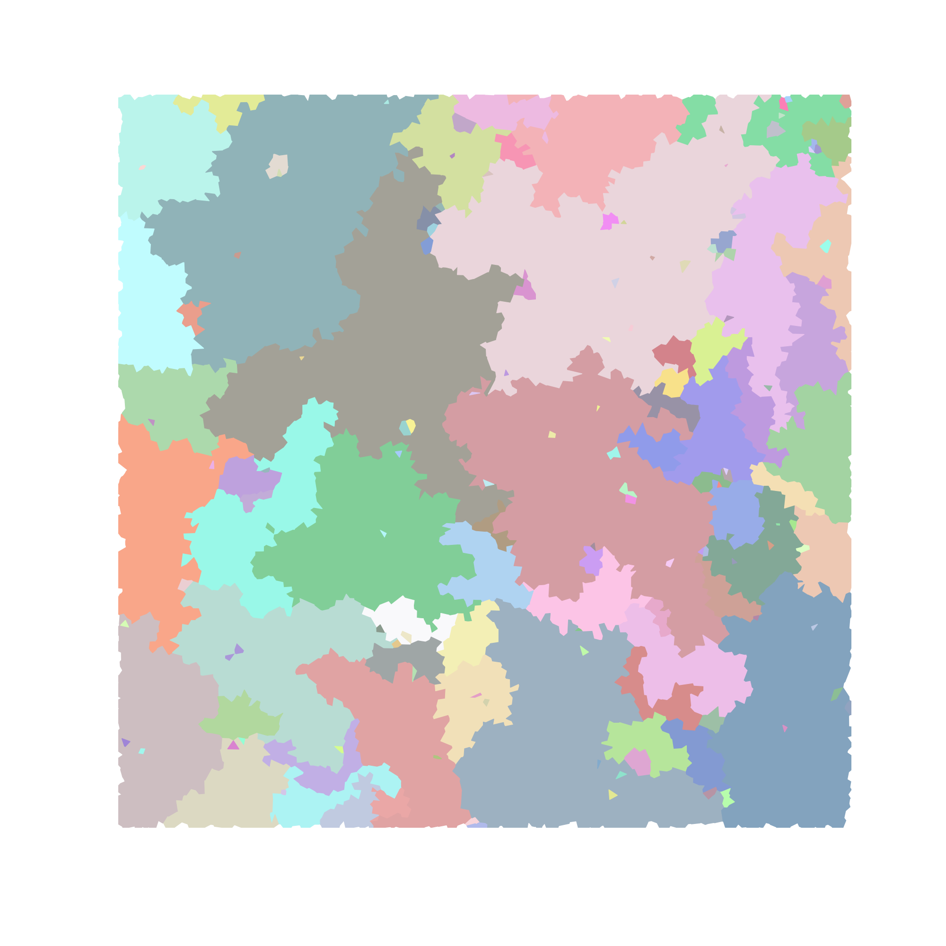
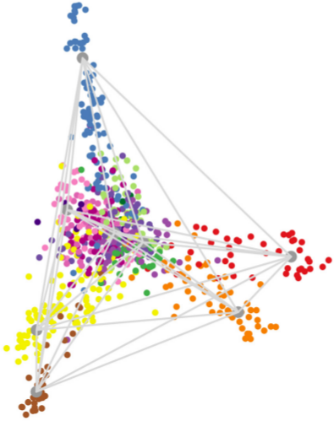
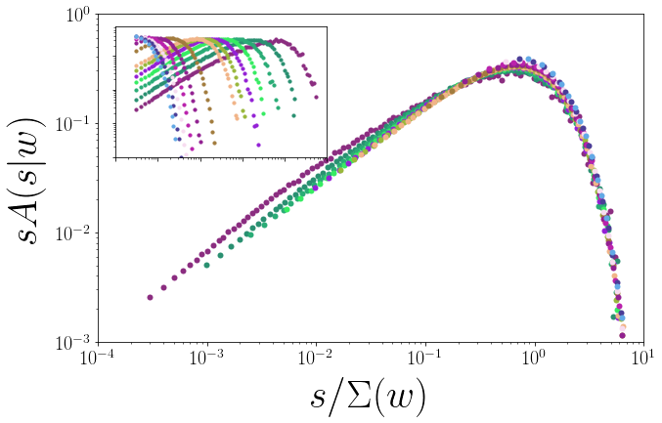
DEALINGS WITH DATA:
PHYSICS, MACHINE LEARNING,
AND GEOMETRY
Lorien Hayden, Phd Defense
Advisor: James Sethna
July 26th, 2019 at 8:00 am in Clark 247
Collecting and interpreting data is key to developing an understanding of the physical underpinnings of observable events. As such, questions of how to generate, curate and otherwise wrangle data become central as systems of interest become increasingly difficult to access experimentally and the sheer quantity of raw information explodes. The data explored in this dissertation covers a wide range of sources and methods. On the more traditional end, we explore simulation data of the two-dimensional non-equilibrium random-field Ising model which we treat with a novel analytic normal form theory of the Renormalization Group. Branching out from condensed matter, we explore machine learning in the context of an unsupervised analysis of sectors of the economy extracted from stock return data and an exploration of the geometical underpinnings of canonical neural networks using a Jeffrey’s Prior sampling of trained networks.

